Slide 1
Challenging cases in Mohs Surgery
Dr Pablo Umbert Millet
Dra. Monica Quintana Codina
University Hospital, Sagrado Corazon, Barcelona
Pablo Umbert Institute

Slide 2
OUR EXPERIENCE IN MMS
We have been pioneers in Spain for 36 years
1981-2017: 6,102 Mohs Micrographic surgeries, Hospital Sagrado Corazon and Institute Pablo Umbert Clínica Corachan
Cure rate evaluation from 2001-2005 and control 6 years later. Relapses in 2.1 % of patients

Slide 3
CASE 1
60-year-old patient with a <1cm tumour located in the left frontotemporal area. 12 Stages 60 sections.

Slide 4
12 Stages 60 sections
Multifocal. Interruption of the technique. Graft.
15-year follow-up: without recurrence.

Slide 5
MULTIPLE SUBCLINICAL SYRINGOMAS DURING MMS IN THE TREATMENT OF BCC
Dermato Surg 2004. Nov 30 (11), 1420 –3.
During MMS one can get confused, with multiple syringomas in the mid dermis
Important: Histologic examination by an expert. Stop the intervention for correct histopathological evaluation

Slide 6
DILATED SWEAT DUCTS SYRINGOMA-TYPE WITH SCALP INFLAMATION
Inflammation →dilated sweat ducts → scarring alopecia
Associated with a traumatic or inflammatory reactive origin
It is not neoplastic but a reactive process
XX Course of Dermatopathology. JL Rodríguez Peralto. March 2017

Slide 7
PEARL 1: Differentiate a carcinoma from non-neoplastic structures
A microcystic carcinoma was located in an area with abundant syringomas
The others areas were multifocal syringomas
.

Slide 8
CASE 2: Referred to our department with a diagnostic error
85-year-old man referred to my clinic with a diagnosis of a 9-month history of a squamous cell carcinoma on the left auricular pavilion associated with hypoacusia
Previous treatment with imiquimod (2 cycles of 6 weeks each)
Previous to MMS, Immediate Cutaneous Diagnosis (ICD) was made
Diagnosis: Recurrent polychondritis of the auricular pavilion (remission with oral corticosteroids)
Forwarded SCC
ICD
Recurrent Polychondritis
Notes:
I learned something new
Imiqwee mod

Slide 9
PEARL 2:
Despite an evident clinical diagnosis, do not start MMS without a confirmatory biopsy
In our department we perform Immediate Cutaneous Diagnosis (ICD) before MMS
WITH GREATER EXPERIENCE ONE HAS GREATER SELF-CONFIDENCE, WHICH SUPPOSES A GREATER RISK OF A MISTAKE. IT IS IMPORTANT TO FOLLOW A STRICT METHODOLOGY

Slide 10
CASE 3: 49-year-old woman referred to our department for MMS for relapsing BCC
January/05: A recurrent BCC in the nasal dorsum and was treated with MMS → 2 Stages, 4 Sections
October/05: 1st Relapse → MMS 2 Stages, 4 Sections
December/06: 2nd Relapse → MMS 2 Stages, 4 Sections
January/07: 3rd Relapse → MMS with large ¨debulking¨, 2 Stages, 9 Sections
Last revision (September/2015): OK

Slide 11
AGGRESIVE TRICHOBLASTOMA (TB)
January/07: 3rd Relapse Post MMS
January/07: Large Debulking. 2 Stages, 9 Sections
How is this possible? The last 2 MMS were negative…!

Slide 12
AGGRESIVE TRICHOBLASTOMA (TB)
Deep folicular basalloid proliferation with mesenchymal stroma: this was the origin of the multifocal aggressive tumours.

Slide 13
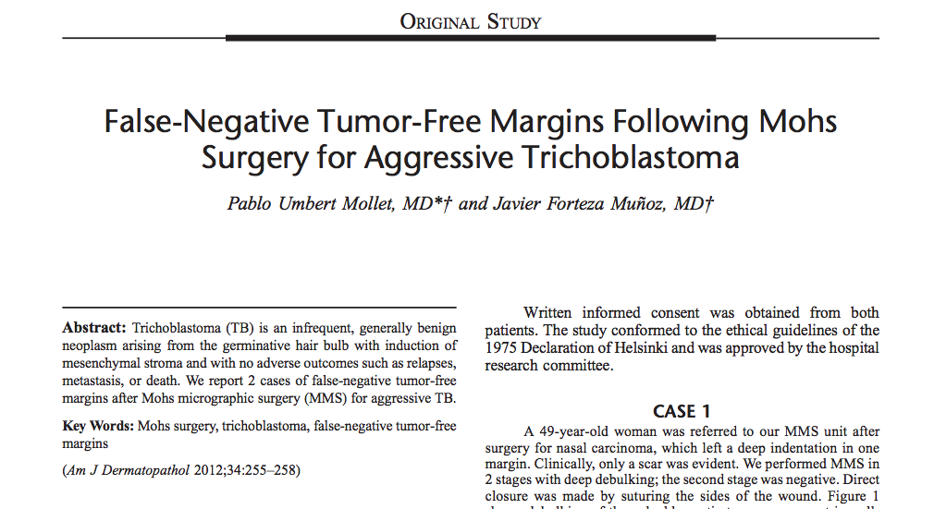

Slide 14
Pearl 3
Adnexal tumors can escape scrutiny due to lack of continuity or multifocality. They have different outcomes vs classical carcinoma

Slide 15
CASE 4
83-year-old patient, CLL, treated with Leukeran. Treated previously with cryotherapy and imiquimod for actinic keratosis.
August 2012: MMS for a hard nodule on the forehead; February 13: 2 new nodules (2cms) relapses of the initial lesion. Surgical excision with unaffected margins
Notes:
Case 4, an with CLL
2 thousand and two
Un affected

Slide 16
RELAPSES OF SQUAMOUS CELL CARCINOMA AFTER MMS IN PATIENTS WITH CHRONIC LYMPHOCYTIC LEUKEMIA
Dermat. Surg 2005, Jan 31 (1). 38- 42
Mayo Clinic. Rochester, Minn- USA
28 patients treated by MMS with 57 SCC → 7 relapses
Accumulative risk of relapse in SCC:
- 4.3 % after 1 year.
- 14.8 % after 3 years.
- 19.0 % after 5 years.
CLL multiplies the risk of relapse by 7
Nowadays, RT after Mohs surgery

Slide 17
PEARL 4: Occurrence of new carcinomas around the scar post-Mohs
Always rule out satellite tumors or metastases
Immunosuppression like our case

Slide 18
PERINEURAL INVASION
Peripheral nerve: can conduct and facilitate invasion
Epineural: with or without continuity of the dermal invasion
Perineural: Affects BCC and SCC
Endoneural: Affects BCC, SCC; affects large nerves

Slide 19
PEARL 5: Don’t forget this possibility, especially at the exit of the cranial foramen
More frequent in SCC
High risk location: area of facial and trigeminal nerves
False negatives
The nerves are wavy
Notes:
Tri geminal

Slide 20
Perineural Invasion and Epithelial Sheath Neuroma after Re-excision, Possibly on a Spectrum of Postinjury Reactive Hyperplasia
Dr. Luis Requena (2000)
In 2016, Beer et al. reported 12 cases under the name of “perineural invasion after re-excision”
Presence of IL-6, which regulates the interface between the nerve and the reactive epithelium.
This knowledge is crucial in order not to confuse it with a perineural invasion

Slide 21
Revision of BCC in internal/external canthus, treated with MMS for 5 years in Hospital Sagrat Cor (1995-1999):
42 cases (38 patients)
Follow-up for a minimum of 4 years and a maximum of 10 years
Relapses 10%
Dr. Enrique Herrera Acosta, Dr. Pablo Umbert

Slide 22
CASE 7: SCC on the scalp with bone involvement
80-year-old patient
Multiple lesions of SCC on the scalp
Previous treatment in 2008 with RT (another hospital)
1st MMS: 30-06-2006
2nd MMS Relapse: 14-09-2007
3rd MMS Relapse: 16-09-2008 (5 Stages- 20 Sections)
Ostioradionecrosis and bone involvement. Referred to Neurosurgery and Plastic surgery departments (craniotomy, cranial prosthesis and flap from occipital hair area)
Follow-up: two years ,OK

Slide 23
PEARL 7
Relapsing SCC in elderly patients: risk of bone involvement
Neurosurgeon: craniotomy + flap
G. Sengul and H. Hadi-Kadioglu: Penetrating Marjolin's ulcer of scalp involving bone, dura mater and brain caused by blunt trauma to the burned area. Neurocirugia 2009; 20:474 – 477.

Slide 24
CASE 8: Cutaneous spindle cell tumours. Challenges in MMS
Differential diagnosis of spindle cell tumours:
- Dermatofibrosarcoma
- Atypical fibroxanthoma
- Squamous cell carcinoma
- Leiomiosarcoma
- Desmoplastic melanoma
- Kaposi sarcoma

Slide 25
CASE 9
36-year-old female patient:
Nodular lesion on the right deltoid region
Skin biopsy: DFSP
Immunohistochemistry:CD34+
Biopsy revision: Compatible with DFSP
We performed MMS: “Debulking”, 1 stage and 8 sections
Last follow-up (2017): OK

Slide 26
8 - PEARL Small primary DFSP (3 cms) Immediate MMS
With local anaesthesia, we performed a 2cm debulking of the infiltrative area
Control of the local anaesthesia amount/time
We performed immediate histopathologic study (frozen sections)
Reconstruction side by side 1 hour later
Large DFSP-→ slow Mohs

Slide 27
PEARL 9
Debulking is important:
- It facilitates the flattening of the edges when sectioning with the cryostat (all the tissue in one plane)
- It permits histopathologic study in paraffin, IHC, FISH (fluorescence in situ hybridization)
CD 34 is not sufficient (occasionally negative). A panel should be performed:
- Vimentin, Actin, Desmin
- S100, CK, CD31, FXIIIa.……….
In problematic cases: FISH DFSP: COL1A1/PDGFB translocation

Slide 28
FALSE RELAPSES
Immunosuppression
Possibility of moving affected or potentially affected skin: flaps or grafts
Collision tumours
Emergence of a new tumour after 10 years, of the same lineage (debatable) or different lineage (field cancerisation)
Previously irradiated area can produce a new carcinoma

Slide 29
FALSE RELAPSES
Multifocality, scars, field of cancerisation
Bad quality and technical problems with the cryostat
Errors in the mapping
Incorrect histopathologic interpretation

Slide 30
How to procede:
Study the reason or origen of the relapse
Examine the previous material (original)
Consultation with colleagues (recognise our limits)
Histopathologic criteria to distinguish false relapses:
NEW PRIMARY TUMOUR: The tumour appears on the flap or graft skin, and does not extend outside the scar line
RELAPSING TUMOUR: It extends inside among the scarring fibrosis and outside

Slide 31
CONCLUSIONS
Mohs Micrographic Surgery is a technique that remains the Gold Standard for the treatment of some tumours
It requires solid training in dermatopathology
Surgical training is nowadays necessary.
Report relapsing cases to other colleagues that perform MMS
Evaluate the technique. Expert committee:
http://esms-mohs.eu/

Slide 32
MY BEST PEARL: DON’T FORGET IT!
THE CLINICOPATHOLOGICAL CORRELATION PREVAILS OVER AN IMMUNOHISTOCHEMICAL MARKER OR A LABORATORY TEST

Slide 33
MMS HAS GIVEN GRATIFYING SATISFACTION TO MY PROFESSIONAL LIFE BECAUSE IT HAS ALLOWED ME TO COORDINATE MY CLINICAL, HISTOPATHOLOGICAL AND SURGICAL KNOWLEDGE PABLO UMBERT MILLET

Slide 34
END

Slide 35
Previous Ttm
Previous symptoms
RX→1
N2→2
SURGERY→5
No TTM →1
EYEBROW FALLING
PAIN
IPSILATERAL FACIAL PARALYSIS
RELAPSES
1 Relapse after 13 months, Inoperable, 3 Relapses after 1st year

Slide 36
SCC on the scalp with bone involvement
88-year-old female patient
2009: In situ SCC on the scalp (4-year history). No previous treatment → CMM is recommended but patient refuses any treatment
2011: Patient comes back with SCC the size of a chestnut
3 MMS were performed, presenting with relapses during the same year
Last MMS: bone involvement. Relapse after 2 months
End of 2011: Patient goes to another centre

Slide 37
PERINEURAL INVASION IN MMS
→ direct invasion route
Cause of local recurrence
Increases morbidity and mortality
Tumours > 2.5 cms.
Incidence rate: 5-15% in SCC
Infrequent in BCC
Nerve size (< 1mm / > 1mm): under discussion
Notes:
needs

Slide 38
Cutaneous spindle cell tumours
51-year-old female patient
8-month history of a 3 cm nodular lesion on the right malar area with progressive growth.
Adhered to skin but not to bone.
Skin biopsy: Malignant mesenchymal tumour Treatment: MOHS SURGERY

Slide 39
NODULAR FASCIITIS
It is important to recognise this reactive pattern, in order to avoid a mistaken diagnosis of sarcoma and to avoid radical and unnecessary surgical treatment
In a lesion initially diagnosed as a DFSP or a cutaneous sarcoma, the original pathological findings should be re-evaluated

